Slide 1

Touchless Order Capture Agent
User Training & UAT
2026

Slide 2

1 | UAT Introduction
2 | Agent Overview
3 | Q&A

Slide 3
1.0 UAT Introduction

Slide 4





UAT Execution Steps and Process Flow
Preparation Review the UAT script before execution begins, and ensure test environment and prerequisite data are prepared
1
Test Execution Participants will be asked to follow the UAT Script in the established time for the UAT (2 weeks), and share feedback or any error encountered
2
Defect/Opportunities Identification Fill out the Excel Sheet with the issues/improvements and add details comments on the issue log
3
UAT Feedback
Share findings in checkpoints with the technical team twice per week.
4
Defect Resolution
FIx and imporve the agent with the feedback received and retest failed cases after defect fixes are deployed
5
UAT Sign-Off
Confirm successful completion of UAT and obtain sign-off from business stakeholders upon successful completion
6
OFi responsability
Envalior responsability

Slide 5
User Acceptance testing (UAT) framework
UAT Framework Overview
UAT Process
The UAT will follow a structured validation framework to verify that the Touchless Order Agent meets all functional and operational requirements before go-live.
Overview
Who?
How?
UAT Introduction Meeting
Align objectives, confirm approach, assignees roles and review timeline
Date: July 06
PMO & Dev. team
KOM Meeting
Defect Management – Severity Definition
Critical | Prevents core functionality; data corruption; system crash
High | Major functionality impacted; workaround exists but inefficient; incorrect calculations
Medium | Minor functionality issue; cosmetic errors; performance degradation
Low | Minor cosmetic issues; documentation errors; usability suggestions
.
Issue Review & Resolution Sessions
Discuss critical issues, agree on fixes and define retest plan, Twice per week
Dev team
& Key users
Review
sessions
Final Validation & Sign off
Review Overall performance, confirm readiness and prepare sign-off
Date: Jul 20
PMO, Dev team
& Key users
Sign off meeting
UAT & Sign-off Criteria
Functional Criteria: All critical and high-priority test cases are passed, core functionalities work as expected and no blocking defects remain. All Critical and High severity defects resolved and retested
Business Criteria: Business scenarios are validated; stakeholders approve outcomes and the process aligns with operational needs
Documentation Criteria: Test results documented, completed and approved
Approval Criteria: formal sign-off from: Business Owner, IT and Project Manager

Slide 6
2.0 Agent Overview

Slide 7
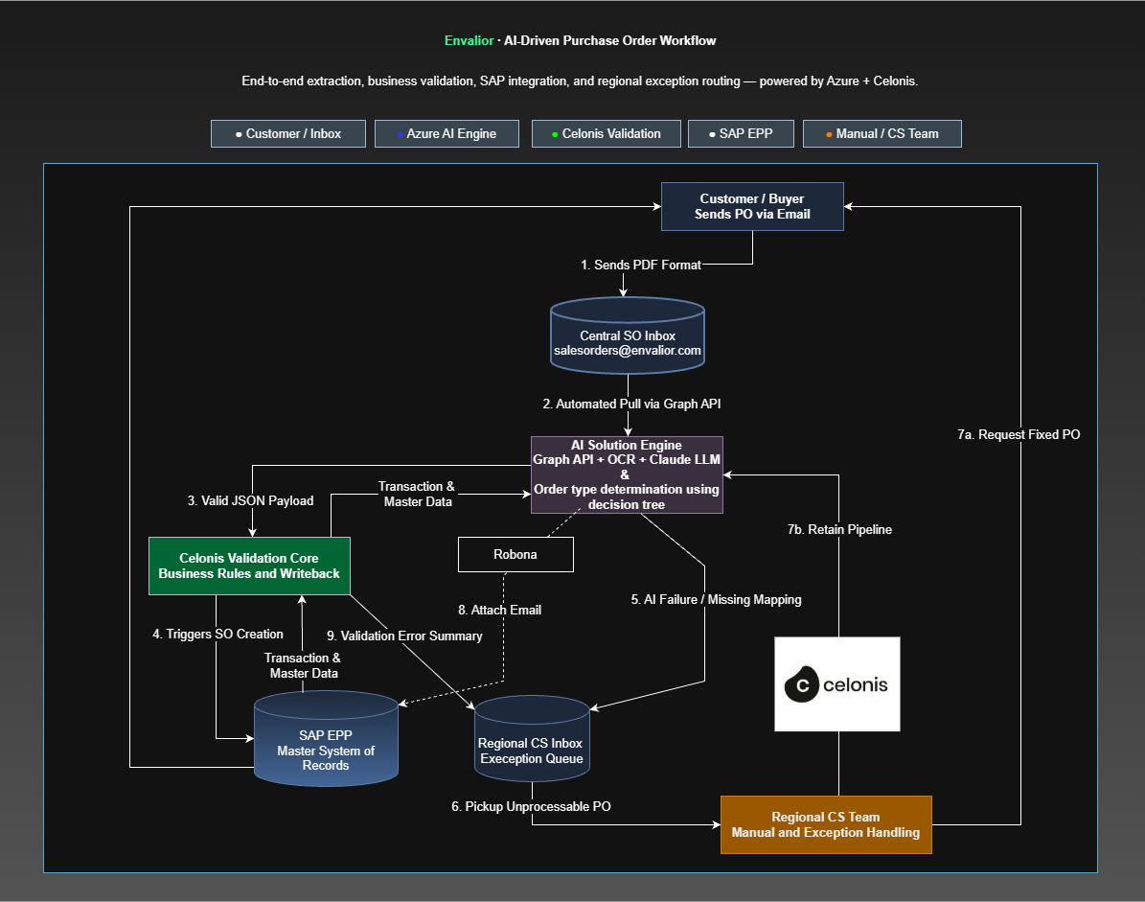
Agent Overview
Touchless Order Creation Agent (TOC)| OM
Challenge
Organizations often struggle with inconsistent order processing across customers, regions, and languages. This lack of automation leads to Purchase Orders being entered manually into SAP, which traps operational capacity and introduces data errors. Multilingual POs (German, Chinese, Spanish) arrive in varying formats, making standardization difficult.
Solution
The TOC Agent automates Sales Order creation using AI through five key steps:
Email Ingestion – Automatically captures PO emails and stores attachments.
AI Extraction – OCR + LLM extracts PO details from multilingual documents.
Master Data Matching – Resolves customer and material mappings using fuzzy matching.
Business Rule Mapping – Applies SAP order rules and material conversions.
SAP Order Creation – Validates data and creates Sales Orders automatically in SAP.
Key Performance Indicators (KPIs)
Touchless Rate: Percentage of POs converted to SAP Sales Orders without any human intervention.
Cycle Time: Time elapsed from email receipt to Sales Order creation
Match Confidence: Fuzzy match score for Sold-To and Ship-To resolution
Exception Rate: Percentage of POs routed to the Regional CS team for manual handling due to low AI confidence or missing mappings.
Feedback Loop Improvement: Tracks how CS corrections update the alias knowledge base, increasing touchless success rate over time.
Material Mapping Rate: Percentage of customer material numbers successfully cross-referenced to internal SAP material numbers via KNMT.

Slide 8
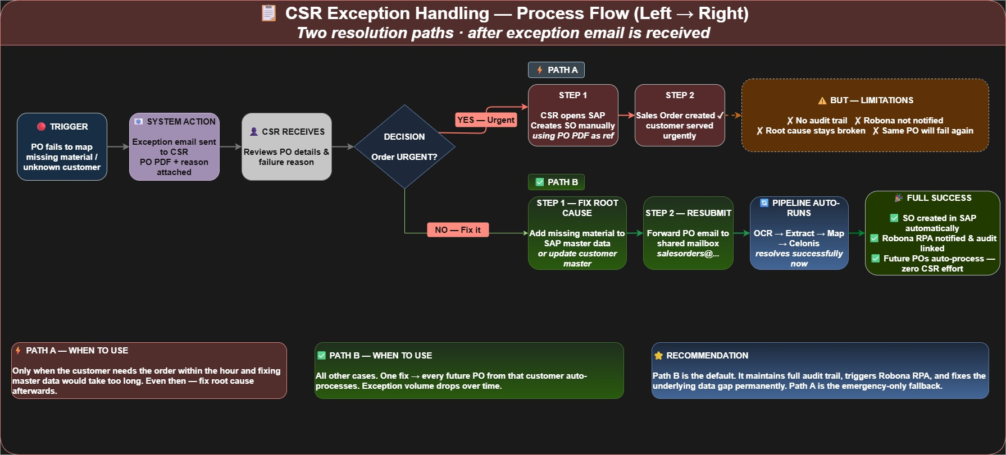
Process Flow for CSR

Slide 9
Additional Support
Touchless Order Creation Agent (TOC) | OM
To ensure smooth operation and quick resolution of any problems, please refer to the appropriate contact below:
Guidance on Business logic
Technical issues and questions
Christian Burwinkel
Christian.Burwinkel@Envalior.com
Atulya Deep
A.Deep@ofiservices.com

Slide 10
3.0 Q&A

